Slide 1

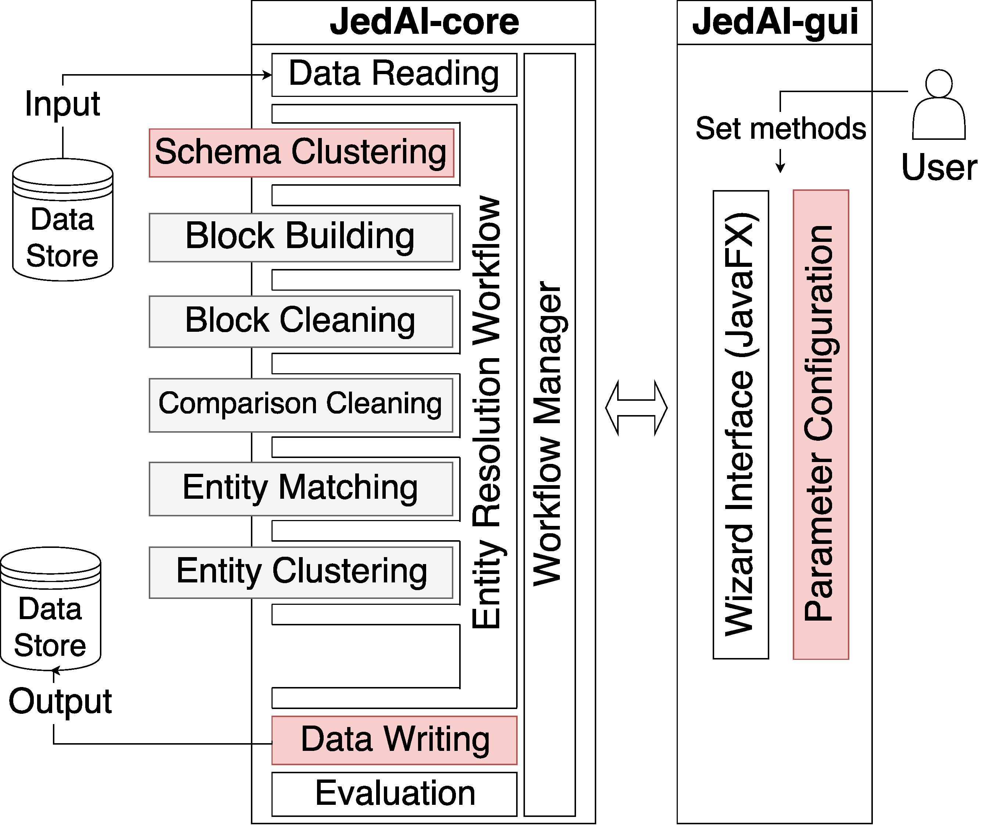
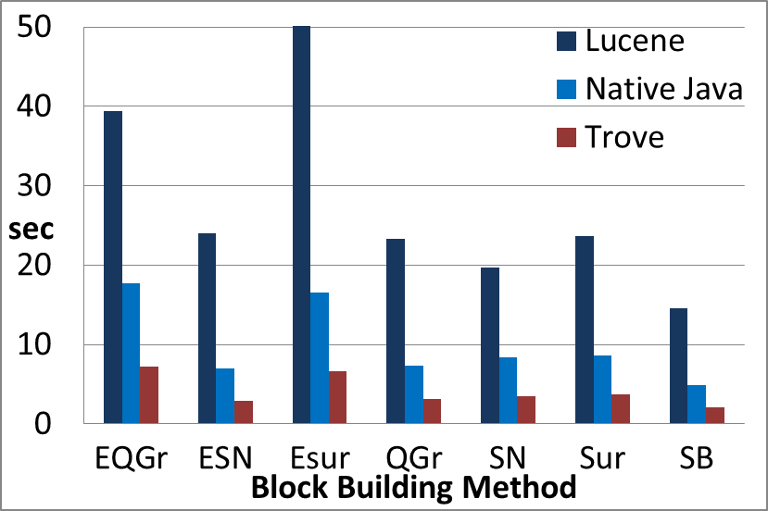
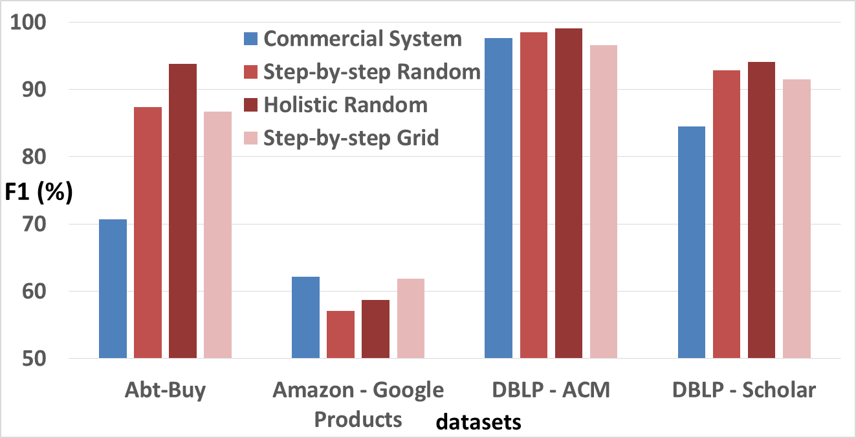






The return of : End-to-End Entity
Resolution for Structured and Semi-Structured Data
George Papadakis, Leonidas Tsekouras, Emmanouil Thanos, George Giannakopoulos, Themis Palpanas, Manolis Koubarakis
What is JedAI (Java gEneric Data Integration)?
What is unique about JedAI v1?
open-source toolkit focusing on Entity Resolution (ER); identifying different entity profiles/records that describe the same real-world object
addresses the Volume and the inherently quadratic complexity of ER, O(n²), through Blocking and Block Processing – similar entities are grouped together in blocks so that comparisons are executed only among them
addresses the Variety of data sources through a schema-agnostic functionality: all methods are generic enough to disregard any schema information
covers both Dirty and Clean-Clean ER
processes both structured (CSV, Relational DBs) and semi-structured (RDF, XML) data in any combination
involves a library of the state-of-the-art unsupervised ER methods that require no domain knowledge; each method is associated with default configurations, requiring no manual fine-tuning
offers GUI for both lay and power users
can be used as a workbench, supporting/allowing comparison of over 10,000 possible ER workflows
Step 1
Step 2
Step 3
Step 4
Step 5
Step 6
Step 7
Step 8
Data Reading
Schema
Clustering
Block
Building
Block
Cleaning
Comparison
Cleaning
Entity
Matching
Entity
Clustering
Data Writing
& Evaluation
Reads files with entity profiles and golden standard.
+ support for SPARQL endpoints.
3 methods for instance-based clustering of attribute names.
Optional step.
Results propagated to other steps.
7 methods for creating schema-agnostic, overlapping blocks.
+ 2 versions of LSH blocking.
3 methods for discarding blocks with useless comparisons. Optional step.
+ Size-based Block Clustering.
7 methods for discarding useless comparisons. Optional step.
+ 2 versions of Canopy Clustering
+ BLAST.
2 methods for executing all retained comparisons.
+ 3 new similarity measures for tf-idf weights, including SiGMa.
7 methods for partitioning similarity graph into equivalence clusters.
+ Star Clustering.
Stores and presents performance results.
All input data formats are supported by Data Writing.
V2 Improvements in
Time Efficiency
V2 Improvements in Effectiveness
V2 Improvements in Usability
GNU Trove offers data structures that operate with primitive types (e.g., int instead of Integer) → smaller memory footprint, faster execution.
Multi-core execution of all methods. Based on a generalization of Multi-core Meta-blocking. Work in progress! To be completed by the end of 2018.
New methods in every workflow step. See above for more details.
Schema Clustering groups together syntactically (not semantically) similar attributes, improving the performance of all workflow steps.
Automatic parameter configuration for individual methods and entire workflows. The latter is efficiently executed by random search; the former also supports a specialized form of grid search.
Manual fine-tuning of all parameters for every method. The GUI provides information about the role and reasonable values of every parameter.
Data Writer stores final results of a workflow or the outcomes of an individual method. All input data formats are supported, from CSV and databases to RDF and SPARQL endpoints.
Data exploration through the GUI allows checking input entity profiles as well as matching results.
V2 updates the modular & extensible architecture
GNU Trove leads to significantly lower running times in blocking.
Automatic configuration outperforms
the domain-specific commercial system.
http://jedai.scify.org

